Slide 1
Dependency Management in Go
Mihai Todor
21.11.2016

Slide 2
Go tooling
Not as complex as CMAKE, MSBuild, SBT etc
Works out of the box for standard use cases
Platform independent
Supports remote 3rd party packages

Slide 3
Go tooling goals
No ugly custom Makefiles required
Figure out dependency trees automatically
Enable reproducible builds by always building everything from source
Blazing fast build times (for what I tried so far)

Slide 4

But watch out for the bumps!
Source: https://www.golang-book.com/books/intro

Slide 5
Packages
All Go code resides inside packages
Act as namespaces
Executable programs are built from a package called “main”
All the source files of a package need to be placed into the same folder and the package name = folder name
Only names prefixed with capital letters are exported

Slide 6
Go workspace folder structure
The $GOPATH environment variable points to the Go workspace folder (unlike Maven’s .m2 folder)
It can contain a list of folders but don’t do that!
Details: https://golang.org/cmd/go/#hdr-GOPATH_environment_variable
/home/user/go/
|-- src/ <- sources
|-- bin/ <- compiled “commands”
└ - pkg/ <- installed package objects
Notes:
- Talk about switching between multiple local trees by changing the $GOPATH

Slide 7
$GOPATH/src folder
Contains all local packages, structured like this:
src
|-- app
| └-- api
|-- github.com
| |-- Neopallium
| | └-- websocket-client-go
| |-- golang
| | └-- lint
| |-- gorilla
| | └-- websocket
| |-- mihaitodor
| | └-- sensu-client-go
| |-- nitro
| | └-- tweety
| |-- streadway
| | └-- amqp
| └-- upfluence
| |-- goutils
| |-- sensu-client-go
| └-- sensu-go
|-- golang.org
| └-- x
| |-- net
| └-- tools
|-- gopkg.in
| └-- alecthomas
| └-- kingpin.v2
└-- sourcegraph.com
└-- sqs
└-- goreturns

Slide 8
Simple package
> src tree app
app
|-- api
| └-- api.go
└-- main.go
> cat app/api/api.go
package api
import "fmt”
func Test() { fmt.Println("Test") }
> cat app/main.go
package main
import "app/api”
func main() { api.Test() }

Slide 9
Remote 3rd party package
package main
import (
log "github.com/Sirupsen/logrus"
)
func main() {
log.WithFields(log.Fields{
"animal": "walrus",
"number": 1,
"size": 10,
}).Info("A walrus appears")
}
Notes:
Men
tion package alias (log in this case)
Mention that _ as alias imports all names without namespace (useful for testing)
Demo:
go build .
go get github.com/Sirupsen/logrus
go build .
./app
godep save
go build -v .

Slide 10
go get
Downloads packages and dependencies into the $GOPATH/src folder
Compiles and installs downloaded packages as binary executables (commands) into the $GOPATH/bin folder
It compiles and installs libraries as static archives into the $GOPATH/pkg folder
More details about the Go build process: https://dave.cheney.net/2013/10/15/how-does-the-go-build-command-work

Slide 11
Remote import paths
go get supports the following version control systems:
Bazaar .bzr
Git .git
Mercurial .hg
Subversion .svn
Example:
> go get github.com/upfluence/sensu-client-go/
More info: https://golang.org/cmd/go/#hdr-Remote_import_paths

Slide 12
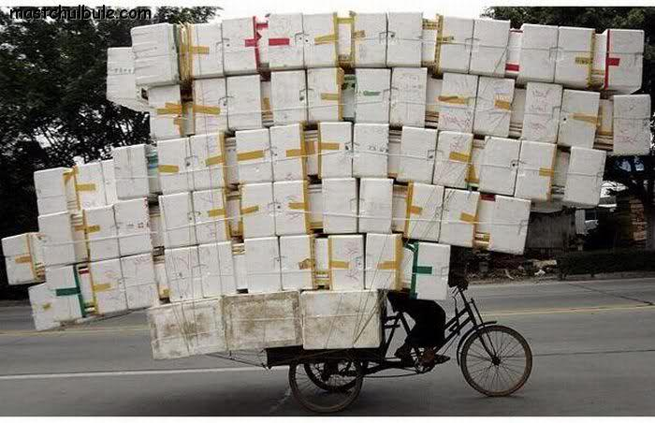
Package management

Slide 13
Package management requirements
Reproducible builds
Versioning
Multiplatform support
Ease of use
Don’t change import paths
Don’t break standard go commands
some 3rd party tools have done it, though

Slide 14
Aside: standard go commands
build compile packages and dependencies
clean remove object files
doc show documentation for package or symbol
env print Go environment information
fix run go tool fix on packages
fmt run gofmt on package sources
generate generate Go files by processing source
get download and install packages and dependencies
install compile and install packages and dependencies
list list packages
run compile and run Go program
test test packages
tool run specified go tool
version print Go version
vet run go tool vet on packages
Source: https://golang.org/cmd/go/
Notes:
Demo `go build –v .` to print included packages

Slide 15
A bit of history
go get fetches the latest version of a package from the master branch
no versioning / tag support
$GOPATH can contain only one single version of a package
Community-driven tools have been developed

Slide 16
First attempt: godep
godep save
Creates a list of all the current 3rd party dependencies in Godeps/Godeps.json
Saves the code of the dependencies in a folder called vendor
Source: https://github.com/tools/godep
More details: https://devcenter.heroku.com/articles/go-dependencies-via-godep

Slide 17
The vendor folder
Introduced in Go 1.6 to enable project vendoring
Available in Go 1.5 with GO15VENDOREXPERIMENT=1
Inspired from https://getgb.io/
Packages copied into vendor shadow packages from $GOPATH
godep doesn’t warn if a dependency is not present in the vendor folder (but exists under $GOPATH)
Source: https://golang.org/cmd/go/#hdr-Vendor_Directories
More details: https://docs.google.com/document/d/1Bz5-UB7g2uPBdOx-rw5t9MxJwkfpx90cqG9AFL0JAYo/edit

Slide 18
A bit of history
Before the vendor folder support was introduced, each 3rd party vendoring tool created their own specific folder
Required wrappers for the standard go tools
Automagically rewrote the import paths
Example: https://github.com/upfluence/sensu-client-go/

Slide 19
Migrating to the vendor folder
See instructions at the end here: https://github.com/tools/godep
Be careful when running `godep restore`, because it alters packages from your $GOPATH

Slide 20
Potential issues
Primitive versioning (no support for releases)
https://help.github.com/articles/about-releases/
Multiple versions of a package can get linked
Dependency flattening is used to solve this when using vendoring
Notes:
Also mention that using a forked library requires updating all imports
How to distribute precompiled libraries (if the build time becomes a concern)?

Slide 21
Potential issues cont’d
No official way of specifying dependencies for library-only modules
Dependency git rev placed in a tool-specific file
Checking in the vendor folder is discouraged here
Potential for leftpad-style issues
Distributing code under the vendor folder might be prohibited by some licenses
Notes:
- Vendoring tools can strip certain parts of the vendored code (such as unit tests) to make it more lightweight

Slide 22
Fixing versioning
Some people argue that new versions of packages should have their own repository
http://stackoverflow.com/a/26546559/1174378
Only a few libraries actually follow this guideline
https://gopkg.in - 3rd party web service
https://gopkg.it - Mercurial support

Slide 23
gopkg.in
Example
go get gopkg.in/alecthomas/kingpin.v2
The number used in the gopkg.in URL represents the major version for the Go package
gopkg.in looks at git tags to figure out major versions
Caveats
Need to rely on another 3rd party intermediary
Not sure how to use it with private repos
Notes:
- Show git log –decorate - When using branches or tags to version the GitHub repository, gopkg.in understands that a selector in the URL such as "v1" may be satisfied by a tag or branch "v1.2" or "v1.2.1" (vMAJOR[.MINOR[.PATCH]]) in the repository, and will select the highest version satisfying the requested selector.

Slide 24
Where to go from here?
LOTS of tools / choices:
https://github.com/golang/go/wiki/PackageManagementTools
An attempted comparison: https://medium.com/@onuryilmaz/comparison-of-go-vendoring-tools-acf019ea476f#.ps6mqehl8
Need to do thorough feature comparisons before choosing one, if deemed necessary
Need to define business requirements first

Slide 25
More resources
Golang UK Conference 2015 - William Kennedy - Dependency Management
https://www.youtube.com/watch?v=CdhucJShJU8

Slide 26
Thank you!
Any questions?

